Slide 1
Day 2

Slide 2
Structural Design Pattern
Decorator
Adapter
Composite
Flyweight
Façade
Proxy

Slide 3
Adapter pattern

Slide 4
What is Adapter Design Pattern?
Two incompatible interfaces or systems can cooperate by using the adapter design pattern, a structural design pattern.
Because of incompatible interfaces, it serves as a bridge between two classes that would not otherwise be able to communicate.
The adapter approach is very helpful when attempting to incorporate third-party libraries or legacy code into a new system.

Slide 5
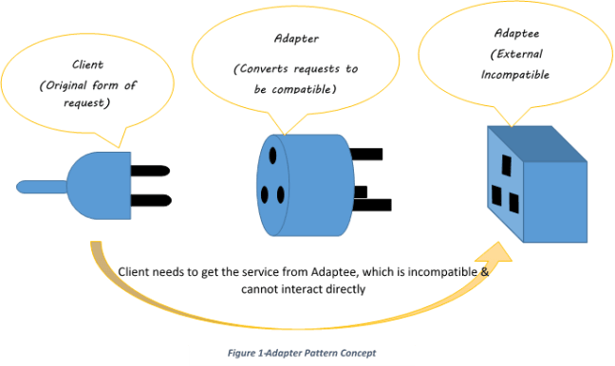
Components of Adapter Design Pattern
Target Interface Description: Defines the interface expected by the client. It represents the set of operations that the client code can use. Role: It's the common interface that the client code interacts with.
Adaptee Description: The existing class or system with an incompatible interface that needs to be integrated into the new system. Role: It's the class or system that the client code cannot directly use due to interface mismatches.
Adapter Description: A class that implements the target interface and internally uses an instance of the adaptee to make it compatible with the target interface. Role: It acts as a bridge, adapting the interface of the adaptee to match the target interface.
Client Description: The code that uses the target interface to interact with objects. It remains unaware of the specific implementation details of the adaptee and the adapter. Role: It's the code that benefits from the integration of the adaptee into the system through the adapter.

Slide 6
Different implementations of Adapter Design Pattern
Class Adapter (Inheritance-based)
In this approach, the adapter class inherits from both the target interface (the one the client expects) and the adaptee (the existing class needing adaptation).
Object Adapter (Composition-based)
The object adapter employs composition instead of inheritance. In this implementation, the adapter holds an instance of the adaptee and implements the target interface.

Slide 7
How Adapter Design Pattern works?
Step 1: The client initiates a request by calling a method on the adapter via the target interface.
Step 2: The adapter maps or transforms the client's request into a format that the adaptee can understand using the adaptee's interface.
Step 3: The adaptee does the actual job based on the translated request from the adapter.
Step 4: The client receives the results of the call, remaining unaware of the adapter's presence or the specific details of the adaptee.

Slide 8
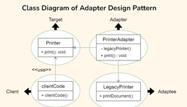
Problem Statement:
Let's consider a scenario where we have an existing system that uses a LegacyPrinter class with a method named printDocument() which we want to adapt into a new system that expects a Printer interface with a method named print(). We'll use the Adapter design pattern to make these two interfaces compatible.

Slide 9
Example
// Target Interface
interface Printer {
void print();
}
// Adaptee
class LegacyPrinter {
public void printDocument() {
System.out.println("Legacy Printer is printing a document.");
}
}
// Adapter
class PrinterAdapter implements Printer {
private LegacyPrinter legacyPrinter;
public PrinterAdapter() {
this.legacyPrinter = new LegacyPrinter();
}
@Override
public void print() {
legacyPrinter.printDocument();
}
}

Slide 10
Example
// Client Code
public class Client {
public static void clientCode(Printer printer) {
printer.print();
}
public static void main(String[] args) {
// Using the Adapter
PrinterAdapter adapter = new PrinterAdapter();
clientCode(adapter);
}
}

Slide 11
Why do we need Adapter Design Pattern?
Integration of Existing Code:
Scenario: When you have existing code or components with interfaces that are incompatible with the interfaces expected by new code or systems.
Need: The Adapter pattern allows you to integrate existing components seamlessly into new systems without modifying their original code.
Reuse of Existing Functionality:
Scenario: When you want to reuse classes or components that provide valuable functionality but don't conform to the desired interface.
Need: The Adapter pattern enables you to reuse existing code by creating an adapter that makes it compatible with the interfaces expected by new code.

Slide 12
Why do we need Adapter Design Pattern?
Interoperability:
Scenario: When you need to make different systems or components work together, especially when they have different interfaces.
Need: The Adapter pattern acts as a bridge, allowing systems with incompatible interfaces to collaborate effectively.
Client-Server Communication:
Scenario: When building client-server applications, and the client expects a specific interface while the server provides a different one.
Need: Adapters help in translating requests and responses between client and server, ensuring smooth communication despite interface differences.

Slide 13
Why do we need Adapter Design Pattern?
Third-Party Library Integration:
Scenario: When incorporating third-party libraries or APIs into a project, and their interfaces do not match the rest of the system.
Need: Adapters make it possible to use external components by providing a compatible interface for the rest of the application.

Slide 14
When not to use Adapter Design Pattern?
When Interfaces Are Stable:
Scenario: If the interfaces of the existing system and the new system are stable and not expected to change frequently.
Reason: Adapters are most beneficial when dealing with evolving or incompatible interfaces. If the interfaces are stable, the overhead of maintaining adapters might outweigh the benefits.
When Direct Modification Is Feasible:
Scenario: If you have control over the source code of the existing system, and it's feasible to directly modify its interface to match the target interface.
Reason: If you can modify the existing code, direct adaptation of interfaces might be a simpler and more straightforward solution than introducing adapters.

Slide 15
When not to use Adapter Design Pattern?
When Performance is Critical:
Scenario: In performance-critical applications where the overhead introduced by the Adapter pattern is not acceptable.
Reason: Adapters may introduce a level of indirection and abstraction, which could have a minor impact on performance. In situations where every bit of performance matters, the Adapter pattern might not be the best choice.
When Multiple Adapters Are Required:
Scenario: If a system requires lot of adapters for various components, and the complexity of managing these adapters becomes difficult.
Reason: Managing a large number of adapters might lead to increased complexity and maintenance challenges. In such cases, reconsider the overall design or explore alternatives.

Slide 16
When not to use Adapter Design Pattern?
When Adapters Introduce Ambiguity:
Scenario: When introducing adapters leads to ambiguity or confusion in the overall system architecture.
Reason: If the presence of adapters makes the system design less clear or harder to understand, it may be worthwhile to explore alternative solutions that offer a clearer design.

Slide 17
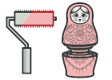
Decorator pattern

Slide 18
Decorator Pattern
Intent
Pattern that attach new behaviors to objects by placing them inside wrapper objects that contain these behaviors.
Problem
Need to add and remove responsibilities to an object dynamically
Inheritance is one of the solution to extend class behaviors.
Inheritance is static, can not add new subclasses to a program when it is already compiled and executed.

Slide 19
Decorator Pattern
Decorator pattern is used a lot in Java IO classes, such as FileReader, bufferedReader etc.
Elements of Decorator Pattern
Component - Interface for objects that can have responsibilities added to them dynamically.
ConcreteComponent - Defines an object to which additional responsibilities can be added.
Decorator - Maintains a reference to a Component object and defines an interface that conforms to Component's interface.
Concrete Decorators - Concrete Decorators extend the functionality of the component by adding state or adding behavior.

Slide 20
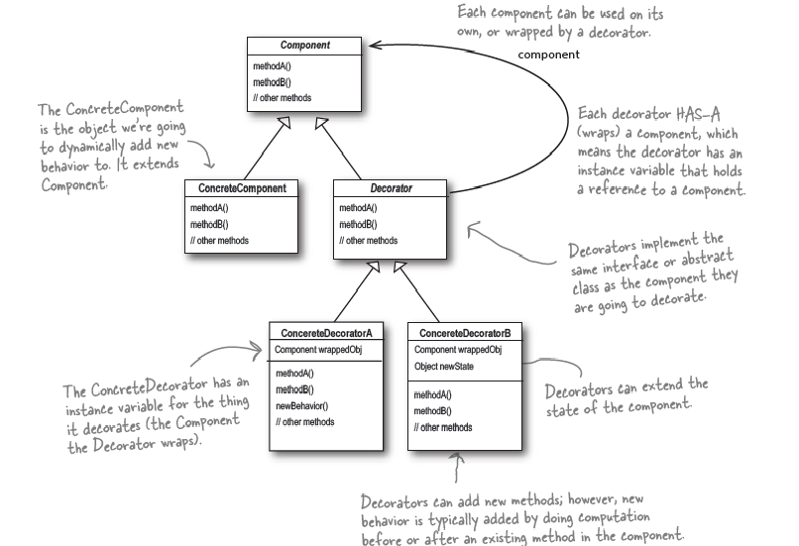
Decorator

Slide 21
Decorator Pattern
The Component- They can be used on its own or wrapped wth Decorator
public abstract class BankAccount {
public abstract double balanceToMaintain();
public abstract double deposit(double amount);
}

Slide 22
Decorator Pattern
The Concrete Component is the object ,to which new behavior is going to added to dynamically, It extends component
//Concrete Component
public class SavingsAccount extends BankAccount {
@Override
public double deposit(double amount) {
return amount;
}
@Override
public double balanceToMaintain() {
return 1000;
}
}

Slide 23
The Decorator
Each decorator Has-A wrapped component, the decorator has an instance variable that hold a reference to the component.
Decorators implement the same interface or abstract class as the component they are going to decorator.
public abstract class FeatureDectorator extends BankAccount {
public abstract double fundTransfer();
public abstract double balanceToMaintain();
}
}

Slide 24
Decorators
public class InternationalBanking extends FeatureDectorator {
private BankAccount account;
public InternationalBanking(BankAccount account) {
this.account=account;
}
@Override
public double fundTransfer() {
// TODO Auto-generated method stub
return 0;
}

Slide 25
Decorator
public class OnlineBanking extends FeatureDectorator {
private BankAccount account;
public OnlineBanking(BankAccount account) {
this.account = account;
}
public double fundTransfer() {
return 8000;
}
public double balanceToMaintain() {
return account.balanceToMaintain()+5000;
}
public double deposit(double amount) {
return 0;
}
public String chequeBookRequest(){
return "Allowed";
}
}

Slide 26
Test Decorators
public static void main(String[] args) {
BankAccount account1 = new SavingsAccount();
System.out.println("Minimum Balance "+account1.balanceToMaintain());
OnlineBanking account1x = new OnlineBanking(account1);
System.out.println("Minimum Balance with One Feature"+account1x.balanceToMaintain());
System.out.println("Cheque Book Request"+account1x.chequeBookRequest());
InternationalBanking account2x = new InternationalBanking(new OnlineBanking(account1));
System.out.println("Minimum Balance with Two Feature"+account2x.balanceToMaintain());
System.out.println("Airport Lounge Access" +account2x.airportLoungeAccess()); }}

Slide 27
Behavioural Design Pattern
Command
Observer
Iterator
Template
Chain of Responsibility
Strategy
Null Object

Slide 28
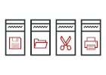
Command pattern

Slide 29
Command Pattern
Intent
Encapsulate a request as an object, thereby letting you parameterize clients with different requests, queue or log requests, and support undoable operations.
Promote "invocation of a method on an object" to full object status
An object-oriented callback
Problem
Need to issue requests to objects without knowing anything about the operation being requested or the receiver of the request.

Slide 30
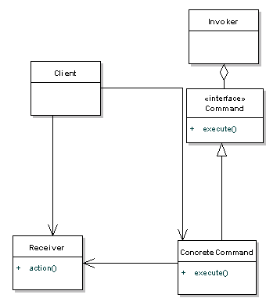
Components of the Command Design Pattern
1. Command Interface : The Command Interface is like a rulebook that all command classes follow. It declares a common method, execute(), ensuring that every concrete command knows how to perform its specific action. It sets the standard for all commands, making it easier for the remote control to manage and execute diverse operations.
2. Concrete Command Classes : Concrete Command Classes are the specific commands, like turning on a TV or adjusting the stereo volume. Each class encapsulates the details of a particular action. These classes act as executable instructions that the remote control can trigger without worrying about the small details.
3. Invoker (Remote Control) : The Invoker, often a remote control, is the one responsible for initiating command execution. It holds a reference to a command but doesn't delve into the specifics of how each command works. It's like a button that, when pressed, makes things happen.
4. Receiver (Devices) : The Receiver is the device that knows how to perform the actual operation associated with a command. It could be a TV, stereo, or any other device. Receivers understand the specific tasks mentioned in commands.
If a command says, "turn on," the Receiver (device) knows precisely how to execute that action.
The Receiver-Command relationship separates responsibilities, making it easy to add new devices or commands without messing with existing functionality.

Slide 31
Problem Statement:
Imagine you are tasked with designing a remote control system for various electronic devices in a smart home. The devices include a TV, a stereo, and potentially other appliances. The goal is to create a flexible remote control that can handle different types of commands for each device, such as turning devices on/off, adjusting settings, or changing channels.

Slide 32
What can be the challenges while implementing this system?
Devices can have different functionalities, so designing a remote control that can easily handle different device types with varying functionalities without becoming highly complex.
Implementing a remote control that supports various commands without tightly coupling ensuring the remote control can execute commands for different devices without needing extensive modifications for each new command.
Designing a system that allows users to customize the behavior of the remote control dynamically.

Slide 33
How Command Pattern help to solve above challenges?
The Command Pattern can be employed to address these challenges. It introduces a level of abstraction between the sender of a command (remote control) and the receiver of the command (electronic devices).
The Command Pattern decouples the sender (Invoker) from the receiver (Devices).
The remote control doesn't need to know the specific details of how each device operates; it only triggers commands.
New devices or commands can be added without modifying existing code.
The remote control can work with any device that implements the common command interface.

Slide 34
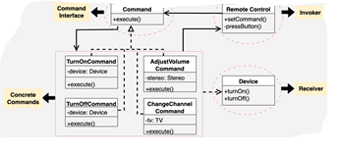
Class Diagram of Command Design Pattern

Slide 35
Example
// Command interface
interface Command {
void execute();
}
// Concrete command for turning a device on
class TurnOnCommand implements Command {
private Device device;
public TurnOnCommand(Device device) {
this.device = device;
}
@Override
public void execute() {
device.turnOn();
}
}

Slide 36
Example
// Concrete command for turning a device off
class TurnOffCommand implements Command {
private Device device;
public TurnOffCommand(Device device) {
this.device = device;
}
@Override
public void execute() {
device.turnOff();
}
}
// Concrete command for adjusting the volume of a stereo
class AdjustVolumeCommand implements Command {
private Stereo stereo;
public AdjustVolumeCommand(Stereo stereo) {
this.stereo = stereo;
}
@Override
public void execute() {
stereo.adjustVolume();
}
}

Slide 37
Example
// Concrete command for changing the channel of a TV
class ChangeChannelCommand implements Command {
private TV tv;
public ChangeChannelCommand(TV tv) {
this.tv = tv;
}
@Override
public void execute() {
tv.changeChannel();
}
}

Slide 38
Example
// Receiver interface
interface Device {
void turnOn();
void turnOff();
}
// Concrete receiver for a TV
class TV implements Device {
@Override
public void turnOn() {
System.out.println("TV is now on");
}
@Override
public void turnOff() {
System.out.println("TV is now off");
}
public void changeChannel() {
System.out.println("Channel changed");
}
}

Slide 39
Example
// Concrete receiver for a stereo
class Stereo implements Device {
@Override
public void turnOn() {
System.out.println("Stereo is now on");
}
@Override
public void turnOff() {
System.out.println("Stereo is now off");
}
public void adjustVolume() {
System.out.println("Volume adjusted");
}
}
// Invoker
class RemoteControl {
private Command command;
public void setCommand(Command command) {
this.command = command;
}
public void pressButton() {
command.execute();
}
}

Slide 40
Example
// Example usage
public class CommandPatternExample {
public static void main(String[] args) {
// Create devices
TV tv = new TV();
Stereo stereo = new Stereo();
// Create command objects
Command turnOnTVCommand = new TurnOnCommand(tv);
Command turnOffTVCommand = new TurnOffCommand(tv);
Command adjustVolumeStereoCommand = new AdjustVolumeCommand(stereo);
Command changeChannelTVCommand = new ChangeChannelCommand(tv);
// Create remote control
RemoteControl remote = new RemoteControl();
// Set and execute commands
remote.setCommand(turnOnTVCommand);
remote.pressButton(); // Outputs: TV is now on
remote.setCommand(adjustVolumeStereoCommand);
remote.pressButton(); // Outputs: Volume adjusted
remote.setCommand(changeChannelTVCommand);
remote.pressButton(); // Outputs: Channel changed
remote.setCommand(turnOffTVCommand);
remote.pressButton(); // Outputs: TV is now off
}
}

Slide 41
When to use the Command Design Pattern
Decoupling is Needed:
In order to separate the requester making the request (the sender) from the object executing it, use the Command Pattern.
Your code will become more expandable and adaptable as a result.
Undo/Redo Functionality is Required:
If you need to support undo and redo operations in your application, the Command Pattern is a good fit.
Each command can encapsulate an operation and its inverse, making it easy to undo or redo actions.

Slide 42
When to use the Command Design Pattern
Support for Queues and Logging:
If you want to maintain a history of commands, log them, or even put them in a queue for execution, the Command Pattern provides a structured way to achieve this.
Dynamic Configuration:
When you need the ability to dynamically configure and assemble commands at runtime, the Command Pattern allows for flexible composition of commands.

Slide 43
When not to use the Command Design Pattern
Simple Operations:
For very simple operations or one-off tasks, introducing the Command Pattern might be overkill.
It's beneficial when you expect your operations to become more complex or when you need to support undo/redo.
Tight Coupling is Acceptable:
If the sender and receiver of a request are tightly coupled and changes in one do not affect the other, using the Command Pattern might introduce unnecessary complexity.

Slide 44
When not to use the Command Design Pattern
Overhead is a Concern:
In scenarios where performance and low overhead are critical factors, introducing the Command Pattern might add some level of indirection and, in turn, impact performance.
Limited Use of Undo/Redo:
If your application does not require undo/redo functionality and you do not anticipate needing to support such features in the future, the Command Pattern might be unnecessary complexity.

Slide 45
State Pattern

Slide 46
What is a State Design Pattern?
Allows an object to change its behavior when its internal state changes. This pattern is particularly useful when an object's behavior depends on its state, and the state can change during the object's lifecycle.
This pattern focuses on managing state transitions and coordinating state-specific behaviors.

Slide 47
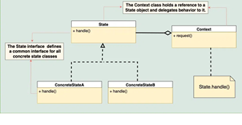
Components of State Design Pattern in Java
Context
The Context is the class that contains the object whose behavior changes based on its internal state. It maintains a reference to the current state object that represents the current state of the Context. The Context provides an interface for clients to interact with and typically delegates state-specific behavior to the current state object.
State Interface or Base Class
The State interface or base class defines a common interface for all concrete state classes. This interface typically declares methods that represent the state-specific behavior that the Context can exhibit. It allows the Context to interact with state objects without knowing their concrete types.
Concrete States
Concrete state classes implement the State interface or extend the base class. Each concrete state class encapsulates the behavior associated with a specific state of the Context. These classes define how the Context behaves when it is in their respective states.

Slide 48
Communication between the components
Step1: Client InteractionThe client interacts with the Context object, either directly or indirectly, by invoking methods on it.
Step2 :Behavior DelegationWhen the client triggers an action or requests a behavior from the Context, the Context delegates the responsibility to its current State object.
Step3 :State-specific Behavior ExecutionThe current State object receives the delegated request and executes the behavior associated with its particular state.
Step4 :Possible State TransitionDepending on the logic implemented within the State object or controlled by the Context, a state transition may occur.
Step5 :Update of Current StateIf a state transition occurs, the Context updates its reference to the new State object, reflecting the change in its internal state.
Step6 :Continued InteractionThe client continues to interact with the Context as needed, and the process repeats, with behavior delegation to the appropriate State object based on the current state of the Context.

Slide 49
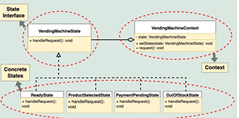
Problem Statement
Imagine a vending machine that sells various products. The vending machine needs to manage different states such as ready to serve, waiting for product selection, processing payment, and handling out-of-stock situations. Design a system that models the behavior of this vending machine efficiently.

Slide 50
Example
interface VendingMachineState {
void handleRequest();
}
class ReadyState implements VendingMachineState {
@Override
public void handleRequest() {
System.out.println("Ready state: Please select a product.");
}
}
class ProductSelectedState implements VendingMachineState {
@Override
public void handleRequest() {
System.out.println("Product selected state: Processing payment.");
}
}
class PaymentPendingState implements VendingMachineState {
@Override
public void handleRequest() {
System.out.println("Payment pending state: Dispensing product.");
}
}

Slide 51
Example
class PaymentPendingState implements VendingMachineState {
@Override
public void handleRequest() {
System.out.println("Payment pending state: Dispensing product.");
}
}
class OutOfStockState implements VendingMachineState {
@Override
public void handleRequest() {
System.out.println("Out of stock state: Product unavailable. Please select another product.");
}
}
class VendingMachineContext {
private VendingMachineState state;
public void setState(VendingMachineState state) {
this.state = state;
}
public void request() {
state.handleRequest();
}
}

Slide 52
Example
public class Main {
public static void main(String[] args) {
// Create context
VendingMachineContext vendingMachine = new VendingMachineContext();
// Set initial state
vendingMachine.setState(new ReadyState());
// Request state change
vendingMachine.request();
// Change state
vendingMachine.setState(new ProductSelectedState());
// Request state change
vendingMachine.request();
// Change state
vendingMachine.setState(new PaymentPendingState());
// Request state change
vendingMachine.request();
// Change state
vendingMachine.setState(new OutOfStockState());
// Request state change
vendingMachine.request();
}
}

Slide 53
When to use the State Design Pattern in Java
The State design pattern is beneficial when you encounter situations with objects whose behavior changes dynamically based on their internal state. Here are some key indicators:
Multiple states with distinct behaviors: If your object exists in several states (e.g., On/Off, Open/Closed, Started/Stopped), and each state dictates unique behaviors, the State pattern can encapsulate this logic effectively.
Complex conditional logic: When conditional statements (if-else or switch-case) become extensive and complex within your object, the State pattern helps organize and separate state-specific behavior into individual classes, enhancing readability and maintainability.

Slide 54
When to use the State Design Pattern in Java
Frequent state changes: If your object transitions between states frequently, the State pattern provides a clear mechanism for managing these transitions and their associated actions.
Adding new states easily: If you anticipate adding new states in the future, the State pattern facilitates this by allowing you to create new state classes without affecting existing ones.

Slide 55
When not to use the State Design Pattern in Java
Few states with simple behavior: If your object has only a few simple states with minimal behavioral differences, the overhead of the State pattern outweighs its benefits. In such cases, simpler conditional logic within the object itself might suffice.
Performance-critical scenarios: The pattern can introduce additional object creation and method calls, potentially impacting performance. If performance is paramount, a different approach might be more suitable.
Over-engineering simple problems: Don't apply the pattern just for the sake of using a design pattern. If your logic is clear and maintainable without it, stick with the simpler solution.

Slide 56
Monolithic Vs Microservice

Slide 57
What is a monolithic architecture?
A monolithic architecture is a traditional model of a software program, which is built as a unified unit that is self-contained and independent from other applications.
The word “monolith” is often attributed to something large and glacial, which isn’t far from the truth of a monolith architecture for software design.
A monolithic architecture is a singular, large computing network with one code base that couples all of the business concerns together.
To make a change to this sort of application requires updating the entire stack by accessing the code base and building and deploying an updated version of the service-side interface.
This makes updates restrictive and time-consuming.
Monoliths can be convenient early on in a project's life for ease of code management, cognitive overhead, and deployment.
This allows everything in the monolith to be released at once.

Slide 58
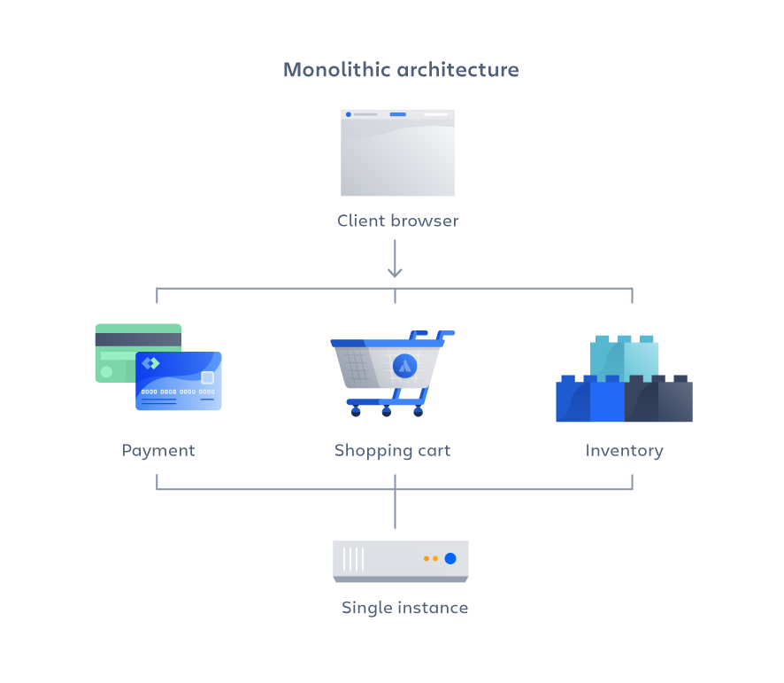

Slide 59
Advantages of a monolithic architecture
Easy deployment – One executable file or directory makes deployment easier.
Development – When an application is built with one code base, it is easier to develop.
Performance – In a centralized code base and repository, one API can often perform the same function that numerous APIs perform with microservices.
Simplified testing – Since a monolithic application is a single, centralized unit, end-to-end testing can be performed faster than with a distributed application. Easy debugging – With all code located in one place, it’s easier to follow a request and find an issue.

Slide 60
Disadvantages of a monolithic architecture
Slower development speed – A large, monolithic application makes development more complex and slower.
Scalability – You can’t scale individual components.
Reliability – If there’s an error in any module, it could affect the entire application’s availability.
Barrier to technology adoption – Any changes in the framework or language affects the entire application, making changes often expensive and time-consuming.
Lack of flexibility – A monolith is constrained by the technologies already used in the monolith.
Deployment – A small change to a monolithic application requires the redeployment of the entire monolith.

Slide 61
What are microservices?
A microservices architecture, also simply known as microservices, is an architectural method that relies on a series of independently deployable services.
These services have their own business logic and database with a specific goal. Updating, testing, deployment, and scaling occur within each service.
Microservices decouple major business, domain-specific concerns into separate, independent code bases.
Microservices don’t reduce complexity, but they make any complexity visible and more manageable by separating tasks into smaller processes that function independently of each other and contribute to the overall whole.

Slide 62
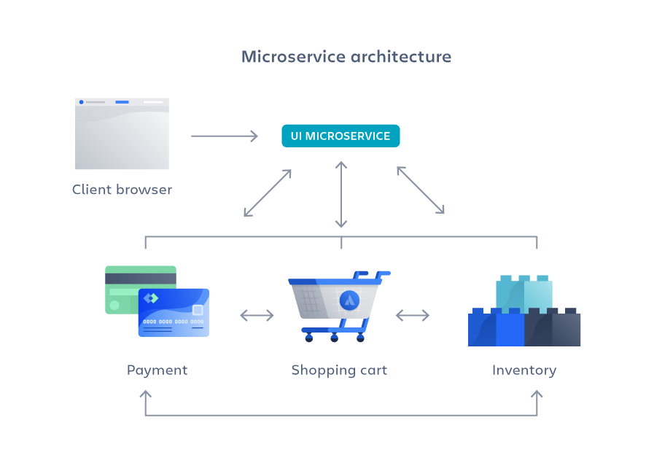

Slide 63
Advantages of microservices
Agility – Promote agile ways of working with small teams that deploy frequently.
Flexible scaling – If a microservice reaches its load capacity, new instances of that service can rapidly be deployed to the accompanying cluster to help relieve pressure. We are now multi-tenanant and stateless with customers spread across multiple instances. Now we can support much larger instance sizes.
Continuous deployment – We now have frequent and faster release cycles. Before we would push out updates once a week and now we can do so about two to three times a day.
Highly maintainable and testable – Teams can experiment with new features and roll back if something doesn’t work. This makes it easier to update code and accelerates time-to-market for new features. Plus, it is easy to isolate and fix faults and bugs in individual services.
Independently deployable – Since microservices are individual units they allow for fast and easy independent deployment of individual features.
Technology flexibility – Microservice architectures allow teams the freedom to select the tools they desire.
High reliability – You can deploy changes for a specific service, without the threat of bringing down the entire application.

Slide 64
Disadvantages of microservices
Development sprawl – Microservices add more complexity compared to a monolith architecture, since there are more services in more places created by multiple teams. If development sprawl isn’t properly managed, it results in slower development speed and poor operational performance.
Exponential infrastructure costs – Each new microservice can have its own cost for test suite, deployment playbooks, hosting infrastructure, monitoring tools, and more.
Added organizational overhead – Teams need to add another level of communication and collaboration to coordinate updates and interfaces.
Debugging challenges – Each microservice has its own set of logs, which makes debugging more complicated. Plus, a single business process can run across multiple machines, further complicating debugging.
Lack of standardization – Without a common platform, there can be a proliferation of languages, logging standards, and monitoring.
Lack of clear ownership – As more services are introduced, so are the number of teams running those services. Over time it becomes difficult to know the available services a team can leverage and who to contact for support.

